Slide 1

Health Insurance cost Prediction
PRESENTED BY
Sachin G T

Slide 2
Health Insurance cost Prediction
Abstract.
Introductions
Work flow
Code using python
Flow chart
Results
Conclusion
References

Slide 3
Abstract:
From past 2 decades, worldwide public health spending’s has nearly doubled along with inflation, reaching 10.8% of global GDP in 2022. Around 60% of comprehensive medical procedures and 70% of outpatient care are provided by multinational multi- private sectors, who charge people exorbitant prices. Health insurance is becoming into a necessity for everyone due to the rising cost of high-quality healthcare, rising life expectancy, and the epidemiological shift toward non-communicable diseases. In the previous ten years, there has been a significant increase in insurance data, and carriers now have access to it. To improve outcomes, the health insurance system looks into predictive modelling.

Slide 4
Introductions:
Health Insurance is a type of insurance that covers medical expenses. A person who has taken a health insurance policy gets health insurance cover by paying a particular amount. There are a lot of factors that determine the cost of health insurance.
The amount of the premium for a health insurance policy depends from person to person, as many factors affect the amount of the cost for a health insurance policy. Let’s say age, a young person is very less likely to have major health problems compared to an older person.
Just like age, many other factors affect the Health Insurance cost Prediction. Hope you now have understood what health insurance is and how the Health Insurance cost Prediction is determined. In the section below PDF i will take you through the task of Health Insurance cost Prediction with Linear Regression Method.

Slide 5
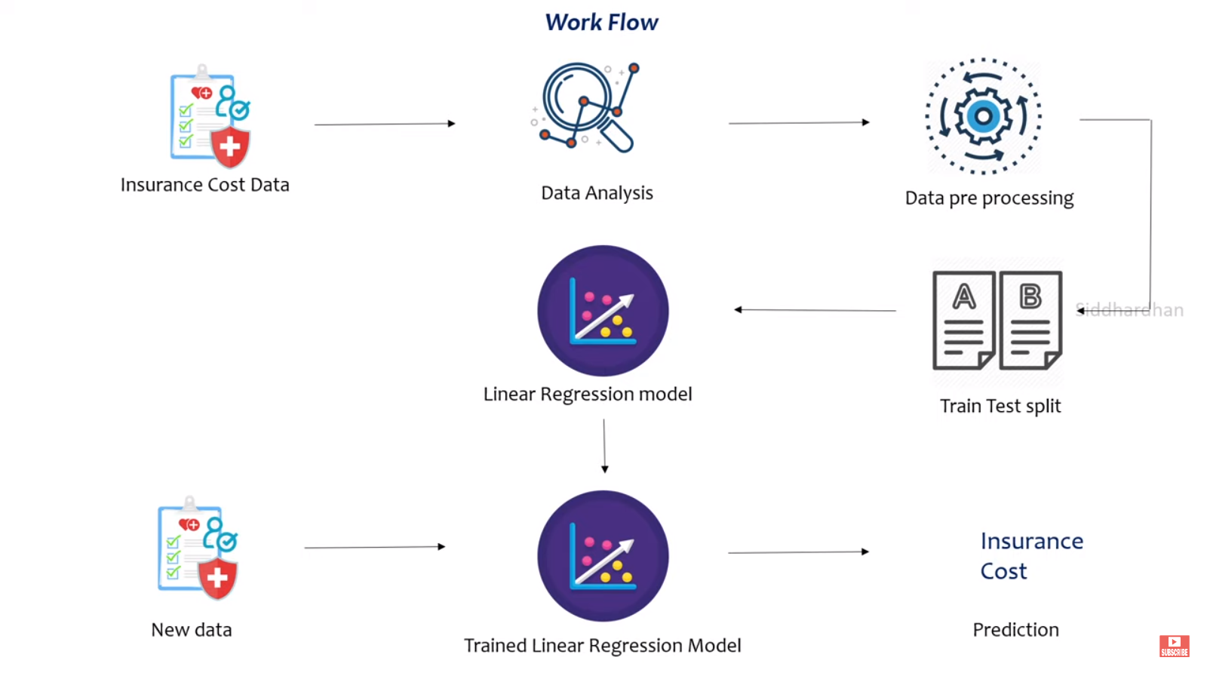
Work Flow :

Slide 6
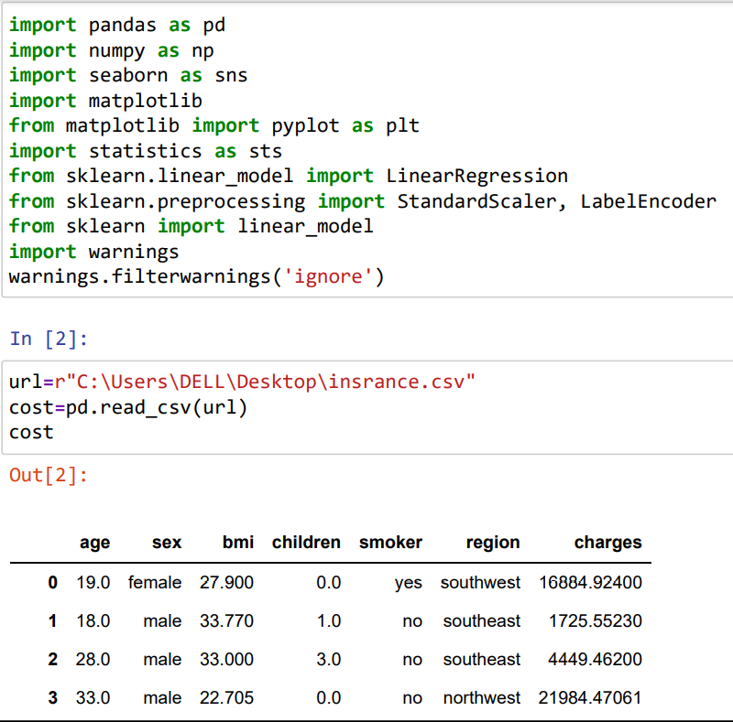
Code using python

Slide 7
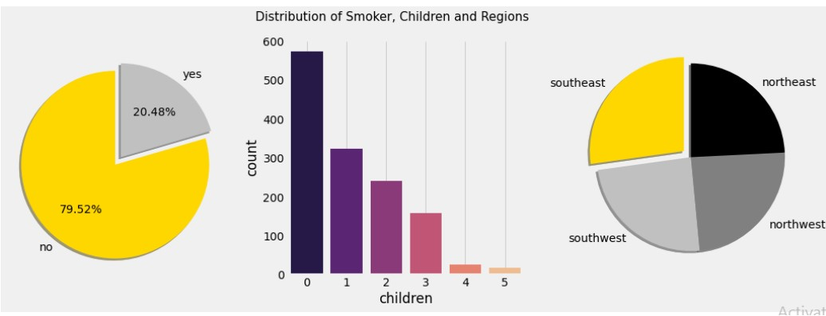
Flow chart

Slide 8
Results:
We see that the accuracy of predicted amount was seen best
In the above plots it says that the sex and region are almost equally divided but the Smokers ration is 80:20
In the above plots we can observe that the charges for males is more as compared to female.
Here smokers are charged more premium than the non-smokers
Premium charges are almost same for region wise

Slide 9
Conclusion
The effect of various independent variables on the amount was also checked. The attributes also in combination were checked for better accuracy results.
Cost Prediction focuses on persons own health rather than other company’s insurance terms and conditions. The models can be applied to the data collected in coming years to predict the cost. This can help not only people but also insurance companies to work in tandem for better and more health centric insurance amount.

Slide 10
References:
https://www.sciencedirect.com/science/article/pii/S1532046419300310
https://en.wikipedia.org/wiki/Healthcare_in_India
https://www.kaggle.com/code/subhakarks/medical-insurance-cost-analysis-and-prediction/notebook
https://economictimes.indiatimes.com/wealth/insure/what-you-need-to- before-buying-health- insurance/articleshow/47983447.cms?from=mdr
https://statistics.laerd.com/spss-tutorials/multiple-regression-using- statistics.php
https://www.zdnet.com/article/the-true-costs-and-roi-of-implementing-
Authors: Mukund Kulkarni, Dhammadeep D. Meshram, Bhagyesh Patil, Rahul More, Mridul Sharma, Pravin Patange
https://www.saedsayad.com/decision_tree_reg.htm
http://www.statsoft.com/Textbook/Boosting-Trees-Regression- Classification

